Slide 2
The paper index
Introduction.
Structure of the remote lab and the experimental system.
Live demo.
Experimental system applications.
A possible class lab.

Slide 3
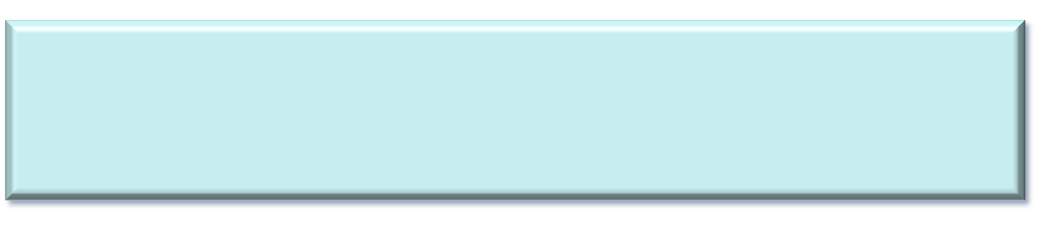
Why a remote lab to handle electric machines?

Slide 4
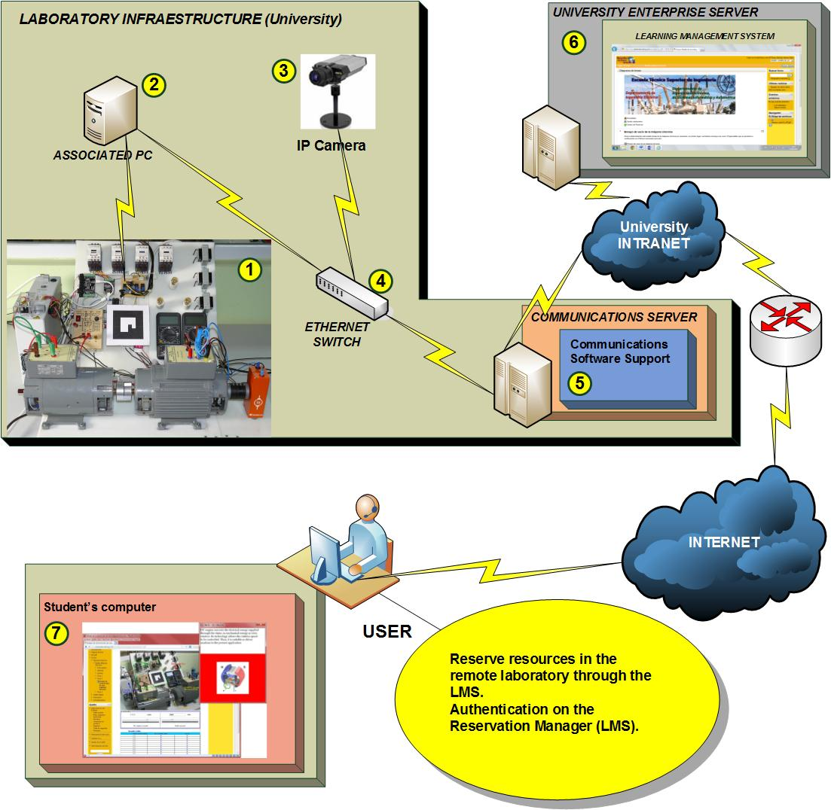
General scheme of the class lab for the remote testing bench
Conectar

Slide 5
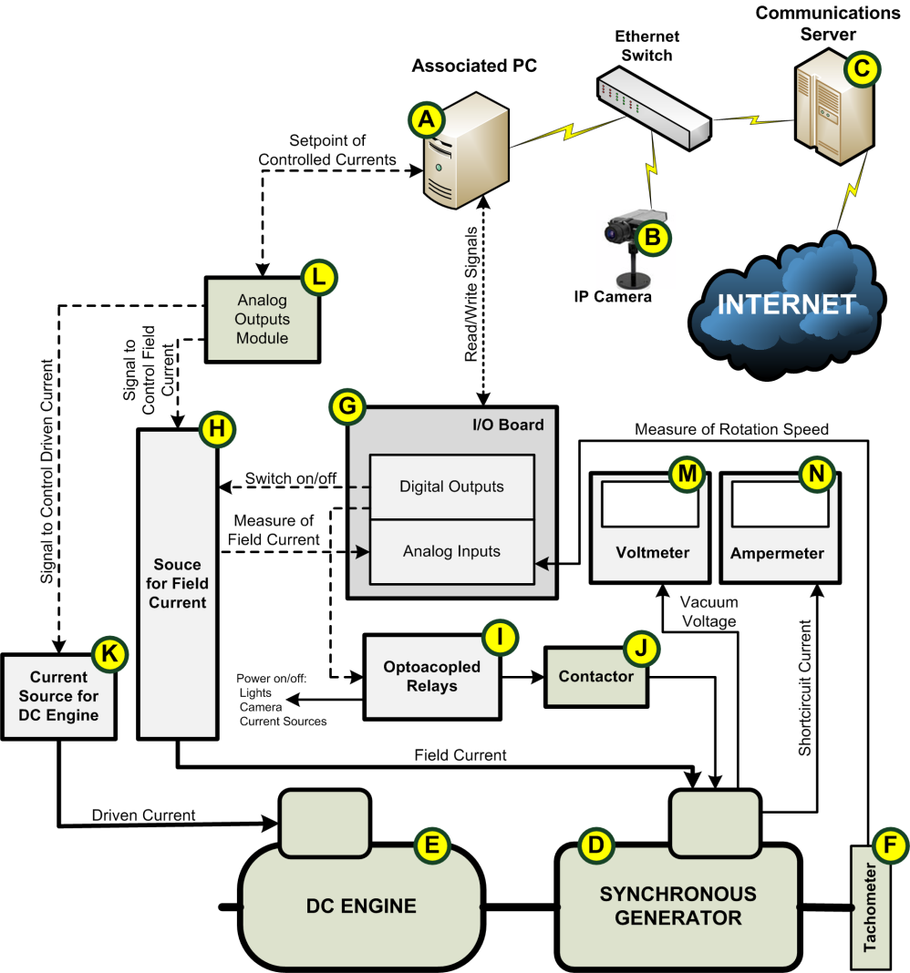
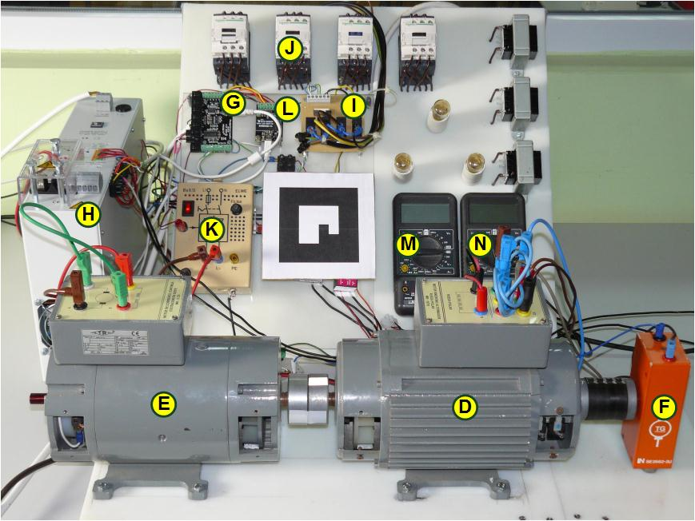
Structure of the experimental system

Slide 6
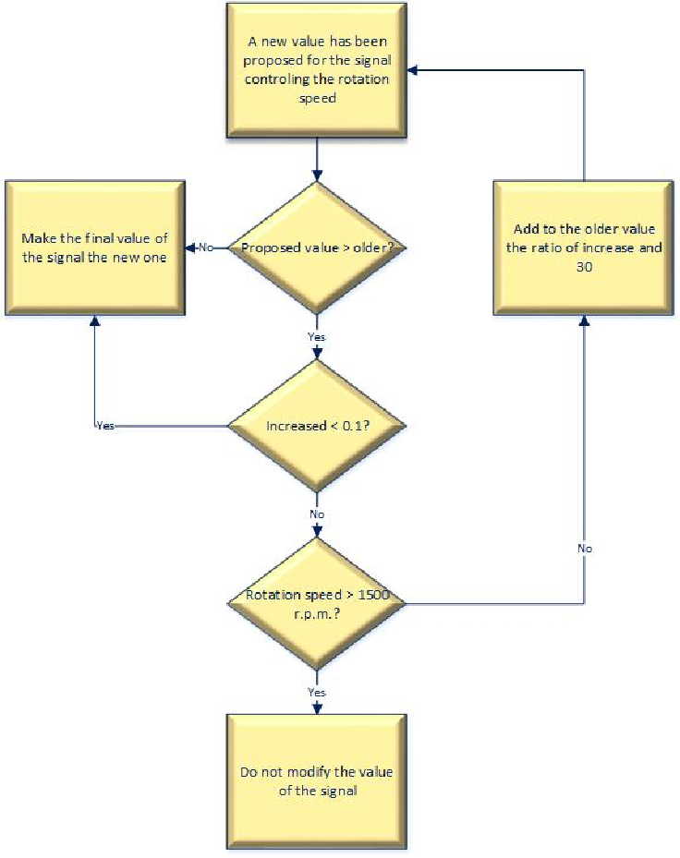
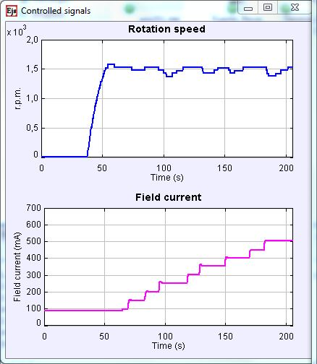
Safety issues
Safety:
Abrupt changes of variables controlled by the user are smoothed by software.

Slide 7
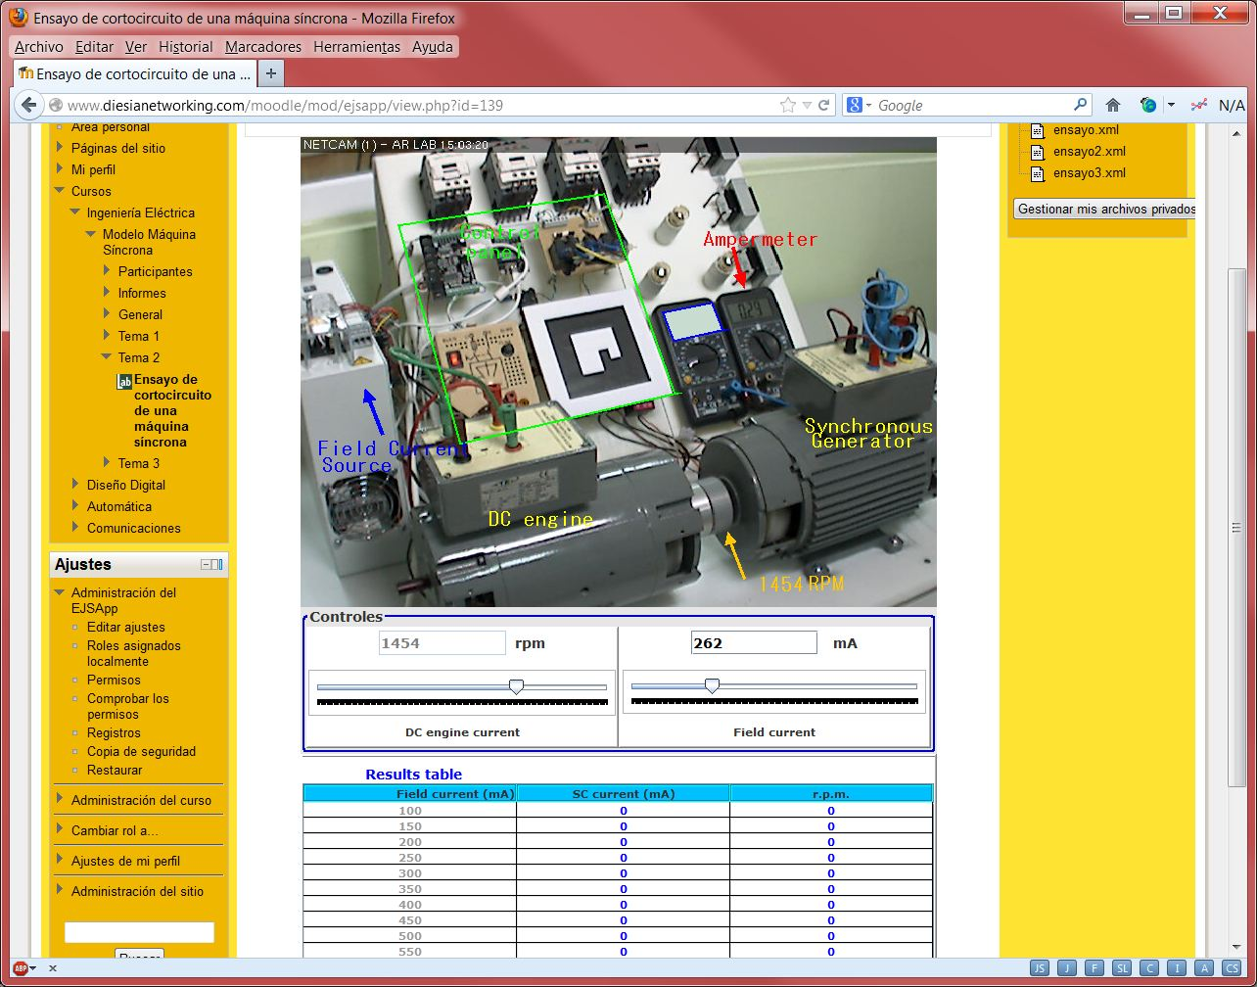
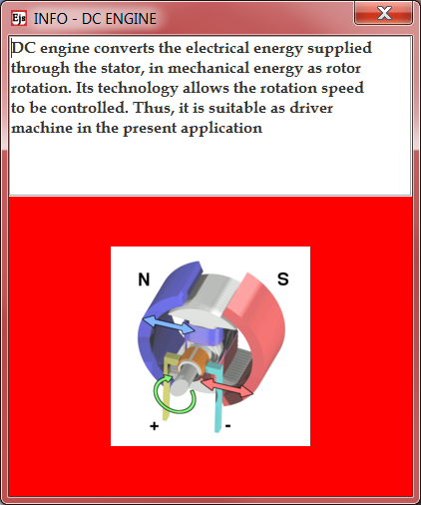
User interface
Conectar

Slide 8
Experimental system applications
Modeling a synchronous machine.
  Establishment of the linear model.
  Establishment of the non-linear model.
  Testing of both models performance.
Operating it within different conditions.
  Connected to a specific load.
  Connected to an infinite power net.
Controlling it.

Slide 9
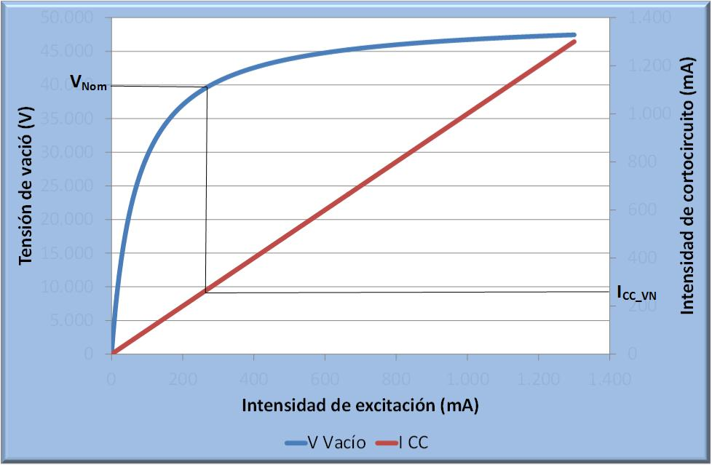
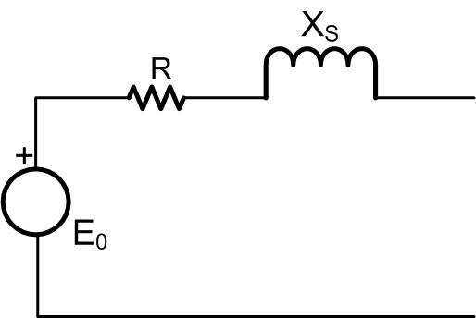
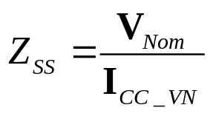

A possible class lab
Vacuum issue.
Short-circuit issue.
Calculation of saturated synchronous impedance.
Calculation of final synchronous impedance.
E₀: Electromotive force.
Z_{s}: Synchronous impedance.
I_{Nom}: Nominal current.

Slide 10
Thanks for your attention

